Slide 1



ARK SECURITY
Phishing: To prepare a software to prevent
phishing

Slide 2

DEPARTMENT OF SCHOOL OF ENGINEERING
Group members:
SY CSE-3
Mini Project - I
Name | Roll no. | e-mail id | Contact no.
S. Utkarsh Rao | 2203153 | utkarshrao1177@gmail.com | 6204644100
Manan Kukreja | 2203180 | manan241202@gmail.com | 9511169915
Mohammad Musaib Akhter | 2203280 | musaabmallick163@gmail.com | 7256013404
Project guide: Dr. Rajani Sajjan

Slide 3

INTRODUCTION
WORKING
01
Problem statement and introduction.
02
Working of the software.
FEATURES
03
Features in the system.
BLOCK DIAGRAM
FLOWCHART
04
Block diagram of the proposed system.
05
Flowchart of the proposed system.
UNIQUENESS
06
How our idea is unique.
APPLICATIONS
CONCLUSION
07
08
Conclusion we made from the project.
Application area of the project.
REFERENCES
LITERATURE SURVEY
09
References we used to get idea of the existing products in market
10
Literature survey of some existing projects on this problem.

Slide 4

PROBLEM STATEMENT
01
To prepare a utility software to prevent phishing
through e-mails and URLs.
INTRODUCTION
Phishing is an act attempting to acquire information such as
User name password and credit card details as a trustworthy
entity in an electronic communication. Communications purporting
to be from popular social websites, auction sites, online payment
process or IT administrators are commonly used to lure the
unsuspecting public. Phishing emails may contain links to website
that are infected with malware.

Slide 5
02
WORKING
If the user receives a mail (say in the name of their
bank) asking to submit details for regular updates
or something as such through an e-mail then as
the user will click on the URL it will direct them to
a website. Here our software comes into play, it
will detect that the website is really an authentic
one or not. If it is authentic then the software will
let you proceed and if it is fake then it will send a
warning message that this website might be fake.

Slide 6
FEATURES
03
Preventing a phishing attack through e-mails and URLs before it begins.
01
02
Detecting a phishing attack.
Preventing the delivery of phishing mails.
03
04
Interfering with the use of compromised information.
Counter measures.
05

Slide 7
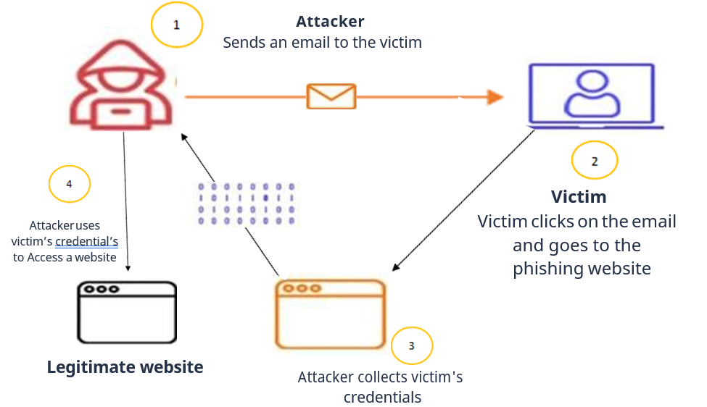
04
BLOCK DIAGRAM

Slide 8
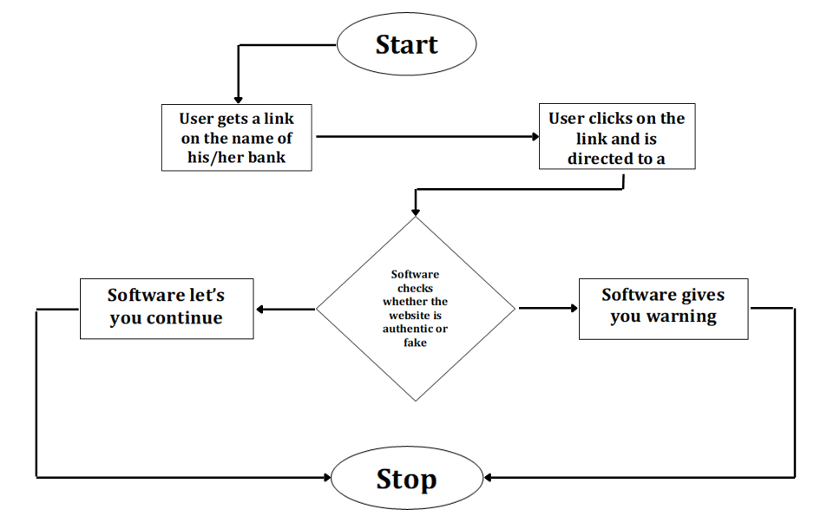
05
FLOWCHART

Slide 9
UNIQUENESS: HOW OUR IDEA IS UNIQUE
SIMPLE UI
CONVINIENT TO USE
EASILY AVAILABLE
06
It is not only restricted to official works and is available to every individual.
Less interfaces will be provided for the frontend.
We will provide it as a chrome extension.

Slide 10
07
APPLICATIONS
Phishing protection software can help to prevent an
attack by shielding employees from suspicious emails,
blocking malicious links, stopping weaponized
attachments and identifying signs of fraud and
impersonation. It is often integrated with web
browsers and email clients as a toolbar that displays
the real domain name for the website the viewer is
visiting, in an attempt to prevent fraudulent websites
from masquerading as other legitimate websites.

Slide 11
08
CONCLUSION
No single technology will completely stop
phishing. However, a combination of good
organization and practice, proper application of
current technologies, and improvements in
security technology has the potential to
drastically reduce the prevalence of phishing and
the losses suffered from it.

Slide 12
09
REFERENCES
1. “Phishing Knowledge based User Modelling in Software Design” - Linfeng Li, Timo Nummenmaa, Eleni Berki, Marko Helenius. Beijing Institute of Petrochemical Technology, Beijing, China, University of Tampere, Tampere, Finland, Tampere University of Technology, Tampere, Finland.
http://ceur-ws.org/Vol-1525/paper-16.pdf
2. “Machine learning based phishing detection from URLs”- Ozgur Koray Sahingoz, Ebubekir Buber, Onder Demir, Banu Diri. Istanbul Kultur University, Computer Engineering Department, 34158 Istanbul, Turkey b Marmara University, Technology Faculty, Computer Engineering Department, Istanbul, Turkey c Yildiz Technical University, Computer Engineering Department, Istanbul, Turkey.
https://www.researchgate.net/profile/EbubekirBuber/publication/344952543_Machine_learning_based_phishin
_detection_from_URLs/lin ks/5f9acba0299bf1b53e4f22e1/Machine-learning-based-phishing-detection-from
URLs.pdf
3. “Types of anti-phishing solutions for phishing attack” - Siti Hawa Apandi, Jamaludin Sallim and Roslina Mohd Sidek Faculty of Computing, College of Computing and Applied Sciences, University Malaysia Pahang, Gambang, Kuantan, Pahang, Malaysia.
https://iopscience.iop.org/article/10.1088/1757-899X/769/1/012072/meta
4. “Phishing E-mail detection based on Structural Properties” - Madhusudhana Chandrasekaran, Krishnan Narayan and Shambhu Upadhyaya Department of computer science engineering, state university of New York at Buffalo.
https://www.albany.edu/wwwres/conf/iasymposium/proceedings/2006/chandrasekaran.pdf

Slide 13
09
REFERENCES
5. “URL based Email Phishing Detection Application” - Roshan Ravi, Abhishek Arvind Shillare, Prathamesh Prakash Bhoir, K.S. Charumathi, B.E. Student, Department of Information Technology, Pillai College of Engineering, New Panvel, Navi Mumbai, Maharashtra – 410206, India 4Assistant Professor, Department of Computer Engineering, Pillai College of Engineering, New Panvel, Navi Mumbai, Maharashtra – 410206, India
https://irjet.com/archives/V8/i4/IRJET-V8I466.pdf
6. “A Transformer-based Model to Detect Phishing URLs” - Pingfan Xu School of Computer Science University of Guelph Guelph, Canada.
https://arxiv.org/pdf/2109.02138.pdf
7. “URL Phishing Analysis using Random Forest” - S. Jagadeesan (Asst. Professor) (jagadeesan.s@ktr.srmuniv.ac.in), Anchit Chaturvedi (anchitmudit@gmail.com), Shashank Kumar(shashank.kumar14@gmail.com), Department of Computer Science and Engineering SRM Institute of Science and Technology Chennai.
http://www.acadpubl.eu/hub/2018-118-21/articles/21e/49.pdf

Slide 14
09
LITERATURE SURVEY
Linfeng Li et. al. proposed the usage of metamodelling frameworks and software tools for
Implementing software systems where phishing prevention is already designed as a part
of the system itself. An expressive computational, verifiable and validatable metamodel is
created that captures user behaviour. Next it is shown through examples that the
metamodel follows and describes reported phishing scams accurately. The model is
then used to create specification in an executable formal specification tool. The formal
specification, which can be executed to observe user behaviour, can be used as a
building block in the specification of a larger software system, resulting in an inherently
phishing-resilient software system design in the form of a formal specification.
Aside from discussing the prevalence of phishing attempts and the
consequences of these attacks, current literature also explores techniques that
may protect against them. Friedman and Hoffman (2008) provide a taxonomy
that divides threats to mobile devices into seven categories, with phishing and
social engineering being one of them. They describe phishing and
social engineering attacks as attempts to dupe computer users into either
sending confidential information to third parties or downloading malware.
They suggest that educating computer users and filtering for malicious content
or spam are the two major defence mechanisms against phishing and social
engineering.

Slide 15

THANK YOU

Slide 16
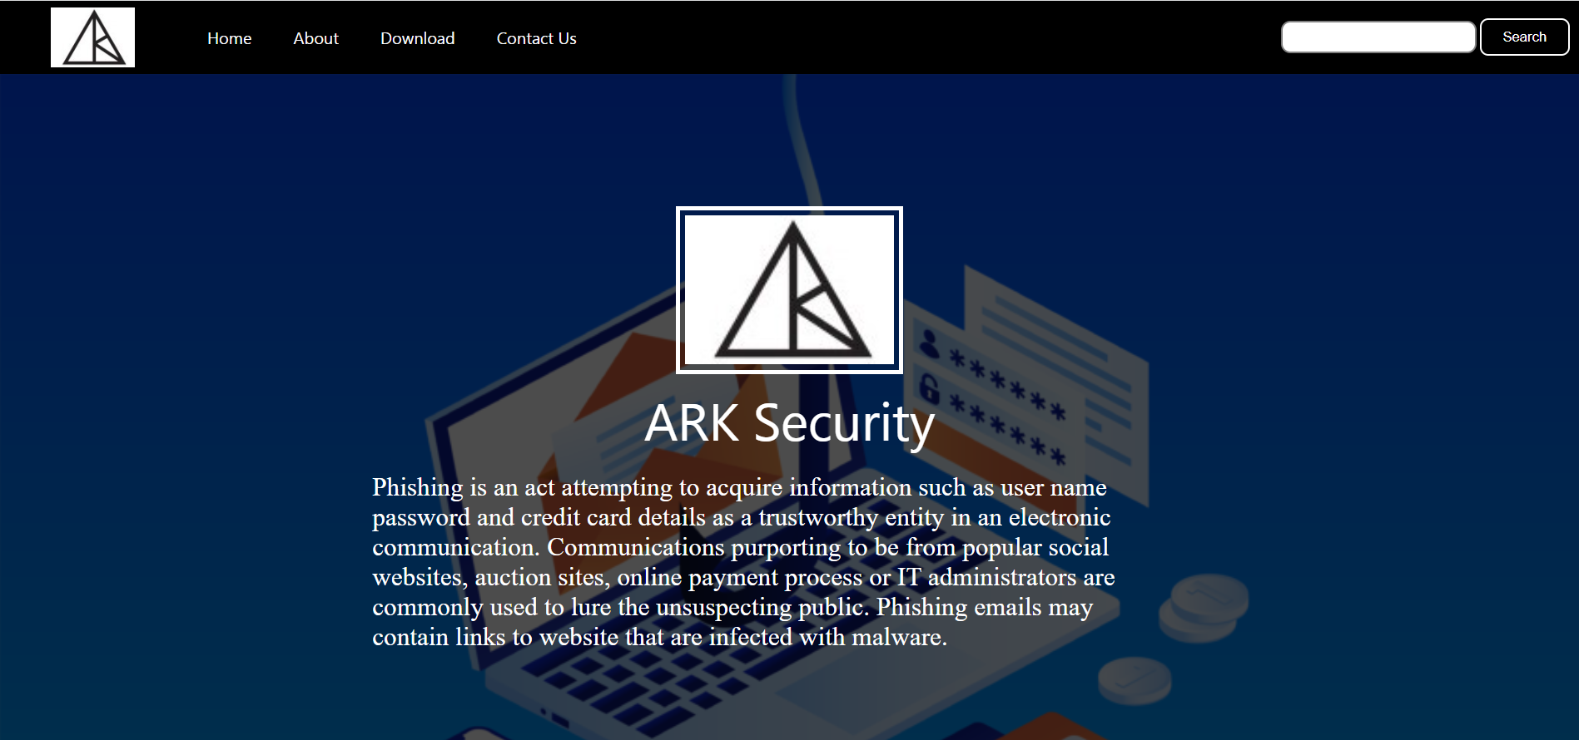
SOFTWARE DESKTOP
This is our website in desktop mode

